Slide 1
DNS Protocol Design, Attacks, and Security
Presented by Michael Earls
Notes:
This presentation is on DNS Design, DNS attacks and DNS security

Slide 2
Who is Michael Earls
A seasoned networking and security technology implementer and planner, Michael has extensive experience with large and complex IT environments in finance and healthcare. His experiences as both an IT end-user and a consulting engineer enable him to consider both realistic business use and technical requirements in designing systems. Michael’s areas of expertise in IT networking and security include: switching and routing; application high availability; application traffic load balancing; core network services (including DNS, DHCP, etc); BGP; 802.11* wireless; firewalls; IPSec VPNs; and strong authentication. He also contributes to open source projects for IP Address Management (phpIP) and syslog-to-mySQl (php-syslog-ng). At Nexum, Michael is a senior security engineer, diagnosing complex issues and designing, testing, implementing sound and secure application delivery systems.
Michael holds a wide range of certifications including:
Cisco Certified Network Professional (CCNP)
Microsoft Certified Professional (MCP+I)
Microsoft Certified Systems Engineer (MCSE)
Infoblox Certified Systems Associate (CISA)
F5 Certified System Engineer (F5-SE-LTM)
F5 Certified System Engineer (F5-SE-GTM)
F5 Certified System Engineer (F5-SE-FirePass)
Notes:
Who is Michael Earls? A seasoned networking and security engineer with extensive experience with large and complex IT environments.

Slide 3
Agenda
DNS Security
DNS Reconnaissance
Cache Poisoning using DNS
Denial of Service Attack (Query Flooding DNS)
Man in the Middle Attacks (DNS Hijacking)
DNS Design Best Practice
Q & A
Notes:
The following Agenda items

Slide 4
Background on DNS
  1970s ARPANET
  Host.txt maintained by the SRI-NIC
  Pulled from a single machine
  Problems
    Traffic and Load
    Name Collisions
    Consistency
  DNS created in 1983 by Paul Mockapetris (RFCs 1034 and 1035), modified, updated, and enhanced by a myriad of subsequent RFCs
Notes:
DNS started out on a single text file and as soon as ARPANET grew this created problems with Name collisions, Traffic and load and consistency. DNS was modified, updated and here it is today..

Slide 5
DNS Security
Why should I care about DNS security?
Why go to the trouble of securing a service that mostly maps names to address?
Notes:
Why should I care about DNS security? During two periods of several days, users around the Internet who typed www.internic.net into their web browsers thinking they were going to InterNICs website instead ended up at a web site belonging to AlterNic. How’d it happen? Someone had “posioned” the caches of major name servers around the world, making them believe the www.internic.net’s address was actually the address of Alternic web server. Imagine someone positing your name server’s cache to direct amazon, or paypay to his own web server.. Further, image typing in your credit card number

Slide 6
DNS in the News
April 7, 2007-- Officials say DNS servers stood up well to attack
April 2, 2007 -- Department of Homeland and Security wants master key for DNSSEC
April 3, 2007 -- A Case Against DNSSEC, Count 1: Solves A Non-Problem
March 26, 2007 -- Hackers Attack Root Servers and Slow Internet Key Traffic
March 9, 2007 -- ICANN: Anycast saved DNS root servers during attack
Feb 23, 2007 -- Anti-DNS Attack Strikes Google Desktop
Feb 6, 2007 -- DoS Attack Cripples Internet Root Servers
Notes:
Latest news regarding DNS

Slide 7
DNS Security
DNS security comes in several flavors
- Secure Names
refusing queries, zone transfers requests, dynamic updates
- Secure Transactions
queries, response, and other messages your name server sends and receives
- Secure Zone data by digitally signing it
Notes:
DNS security is one of the most complicated topics in DNS, we will start off with the easy and build up to the hard stuff

Slide 8
DNS Security
Securing Your Name Server
- BIND Version
- Restricting Queries
- Unauthorized Zone Transfers
- Chroot BIND
- DNSSEC
- Other DNS
Notes:
I will cover the following items listed above as steps to help secure your Name server.

Slide 9
DNS Security
BIND Version
BIND version 8.2 and later allow you to tailor your name server’s response to the version.bind query
@p dig txt chaos version.bind
;; ANSWER SECTION:
version.bind. 0 CH TXT “9.1.2”
Under BIND options add the following line to change your response version “Not known”;
Notes:
Since Bind version 8.2 the option to change the response of bind version should make it harder and limit the number of possibilities for the attacker to guess the version running.

Slide 10
DNS Security
Restricting Queries
BIND version 8 and 9 allow-query substatements per zone or global
Zone specific ACL take precedence over global ACLs
Restricting all queries
Global form of allow-query:
options {
allow-query { address_match_list;};
};
zone “example.net” {
allow-query { “example-net”; };
};
Notes:
Bind allows you to restricted queries global or per zone using network or host based ACLs by providing the substatement option.

Slide 11
DNS Security
Prevent Unauthorized Zone Transfers
Limit zone transfers to your slaves only
BIND 8 and 9 substatement “allow-transfer”
Allow global or per zone access control
zone “example.net” {
type slave;
file “bak.example.net”;
masters { 10.250.30.53; };
allow-transfer { “192.168.1.0/24”; };
};
or
allow-transfer { “none”; };
Notes:
Bind also allows you to restrict zone transfers global or per zone to control who can pull full resource record data using the substatement.

Slide 12
DNS Security
Chroot BIND
BIND normally runs as root
Vulnerability in BIND == unfettered root access
BIND version 8.1.2 added support for least privilege
BIND version 8.1.2 added support chroot
Google it
Notes:
Since Bind version 8.1.2 a feature allowing Bind to run with minimal set of rights needed to do it job and to support a chroot environment.
What is Chroot? Change the way the application believes the file system is setup, limited directory access

Slide 13
DNS Security
DNSSEC
Public Key cryptography
Digitally sign zone data
Public and private keys (asymmetric cryptographic algorithms)
Added new Resource Records to support DNSSEC
Key - public key associated with a zone
Sig - private key associated with a zone
NXT – next resource record
Notes:
DNSSEC is one of the most complicated subjects pertaining to DNS security utilizing public key cryptography to sign zone data

Slide 14
DNS Security
DNSSEC Performance
DNSSEC increased average DNS message size
Signing multiplies the zone by a factor of seven
DNS messages are truncated -> Use of TCP
TCP is more resource intensive then UDP
Complexity
Notes:
By utilizing DNSSEC Bind might experience performance issue regarding CPU resources, Network bandwidth and design complexity.

Slide 15
DNS Security
Other DNS
Windows
Djbdns
MaraDNS
Notes:
Other variants of DNS were created to become Security-aware dns servers like djbbind and maradns have a better track record then BIND

Slide 16
DNS Security
TSIG
Securing DNS messages with transaction signatures. One way-hash function to authenticate DNS messages
Meta-record that will never appear in zone data and is never cached by a resolver or name servers
Notes:
By utilizing shared keys and one-way hashing a signer adds the transaction signature record to a DNS message, the recipient removes and verifies the record before doing anything further, such as caching the data in the message.

Slide 17
DNS Security
Configuring TSIG
Usage:
dnssec-keygen -a alg -b bits -n type [options] name
dnssec-keygen -a HMAC-MD5 -b 128 -n HOST example-plat.example.org.
Kexample-plat.example.org.+157+60899
plat@ cat Kexample-plat.example.org.+157+60899.key
example-plat.example.org. IN KEY 512 3 157 qnwVtGAh27MAyiTlSYx9BQ==
plat@ cat Kexample-plat.example.org.+157+60899.private
Private-key-format: v1.2
Algorithm: 157 (HMAC_MD5)
Key: qnwVtGAh27MAyiTlSYx9BQ==
Include “/etc/dns.keys.conf”;
Notes:
We need to configure a common key between our name servers, utilizing shared keys and one-way hashing to identifying each endpoint of a connection as being allowed to make or respond to a DNS update .

Slide 18
DNS Security
Using TSIG
server (10.10.10.10) {
keys {example-plat.example.org.;};
};
zone “example.org” {
type master;
file “db.example.org”;
allow-transfer { key example-plat.example.org.; };
};
Notes:
The server substatement tells the local name server to sign all such requests sent to the IP listed
We also can restrict zone transfers to those signed with the TISG key per zone.

Slide 19
DNS Reconnaissance
The act of enumerating hosts through name servers, network scans, and search engine.
Notes:
What is DNS Reconnaissance ? It’s a method of gathering data though exploration using network scans, name servers, and search engines

Slide 20
Example of DNS Reconnaissance
Tools used within this example:
- Host
- Whois
- Dig
- Bash scripting
Notes:
dig microsoft.com NS
./searchDns-r.sh 207.68.160

Slide 21
Cache Poisoning using DNS
DNS cache is deliberately contaminated by an attacker done by DNS Transaction ID predication or recursive queries.
Notes:
What is Cache Poisoning? It’s a method of deliberately providing false resource records into the a zone by predicating the transaction Id or flooding the recursive query engine.

Slide 22
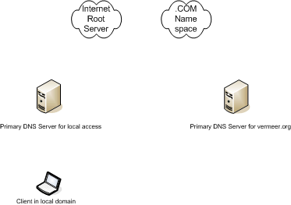






Example of a DNS query
DNS Name Resolution Request
Notes:
Step 1. The client will contact its configured DNS server and ask for www.example.org. This query will contain information about the client’s source UDP port , IP address and a DNS transaction ID
Step 2. the client’s DNS server is not authoritative for www.example.org. Using recursive queries via the Internet root DNS servers contact example.org DNS server and answer the query.
Step 3. Successful query will then be passed back to the client and the information will be cached by the local DNS and the client.
Important Notes:
Step 3. the client will only accept the information returned if the DNS server uses the clients correct source port and address in addition to the correct DNS transaction ID (noted in step 1). Three pieces of information is required to accept DNS replies.

Slide 23
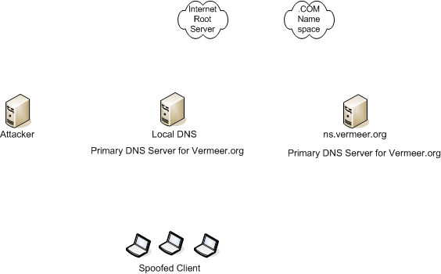



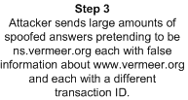


Cache Poisoning using DNS
Notes:
Step1. The attacker would send a large number of resolution requests each spoofed with a different source IP information for www.example.org to local DNS server. The logic of sending many requests is that each request will be assigned a unique transaction IP and even though all requests are for the same domain name, each will be processed independently.
Step2. The local DNS will send each of theses requests to other DNS servers and eventually ns.example.org as highlighted at the top of this section. Local Name server is awaiting a large number of replies from ns.example.org
Step3. The attacker uses this wait stage to bombard local DNS with spoofed replies from ns.example.org stating that www.example.org points to an IP address which is under the attacker’s control (false information). Each spoofed reply has a different transaction ID. The attacker hopes to guess the correct transaction ID as used by the two name servers
If the attacker is successful the information will be stored in the local cache
This is really a name server to name server attack only affecting clients who user the target name server.
BIND transactional ID’s range 1-65535

Slide 24
Cache Poisoning using DNS
Three key pieces of information are required for this query to be accepted
- Transaction ID
- Source IP
- Source Port
Sniffed output of dig:
172.22.22.22.22445 > 64.44.50.100.53
172.22.22.22.22445 > 12.30.53.56.53
172.22.22.22.22445 > 36.98.12.10.53
Bind version 4 and 8 use sequential transaction ID’s
Bind version 9 assigns transaction ID’s on random basis using /dev/random
Notes:
With Bind version 4 or 8 all three queries used the same source port while querying four different name servers (as pictured in RED), Bind version 9 changed this option to use /dev/random instead to create the source port.

Slide 25
Cache Poisoning using DNS
The first of the scripts used is called poison.pl and was released as proof of concept.
poison.pl (ip) (domain)
hds0.pl (source ip) (destination ip) (source port) (domain)
To observe if the attack was successful a simple dig query on the target name server
dig @ns www.example.net
www.example.net 86400 IN A 1.1.1.1
Notes:
This attacked was done is a lab environment on Bind version 8 and poisoned the domain name for example.net to point to a secure not hosting by example.net.

Slide 26
Denial of Service Attack
(Query Flooding)
UDP flooding the DNS listener with spoofed or bogus data starving, the server of resources
DNS query are over UDP, denial of service attacks are almost impossible to trace and block
Notes:
What is Query Flooding? It’s a method to starve server resources from providing quick response to the client requesting information

Slide 27
Denial of Service Attack
(Query Flooding)
The script used is called dnsFlood.pl and was released as proof of concept sending thousands of rapid DNS requests to the name server causing it to return results slower.
dnsFlood.pl (ip)
attacked: (ip)
Notes:
Again, This attacked was done is a lab environment on Bind version 8 , 9 and windows 2000 causing the server services to become slow to respond to normal requests

Slide 28
Denial of Service Attack
(Query Flooding)
@plat:~$ sudo tcpdump -vvv -X dst port 53
tcpdump: listening on eth0, link-type EN10MB (Ethernet), capture size 96 bytes
13:45:55.893257 IP (tos 0x0, ttl 64, id 1565, offset 0, flags [none], proto: UDP (17), length: 52) 208.143.176.7.domain > 192.168.1.20.domain: [udp sum ok] 40156+ A? dq.net. (24)
0x0000: 4500 0034 061d 0000 4011 3249 d08f b007 E..4....@.2I....
0x0010: c0a8 0114 0035 0035 0020 c943 9cdc 0100 .....5.5...C....
0x0020: 0001 0000 0000 0000 0264 7103 6e65 7400 .........dq.net.
0x0030: 0001 0001 ....
13:45:55.895559 IP (tos 0x0, ttl 64, id 1565, offset 0, flags [none], proto: UDP (17), length: 53) 103.254.200.105.domain > 192.168.1.20.domain: [udp sum ok] 40157+ A? dqr.org. (25)
0x0000: 4500 0035 061d 0000 4011 8277 67fe c869 E..5....@..wg..i
0x0010: c0a8 0114 0035 0035 0021 8292 9cdd 0100 .....5.5.!......
0x0020: 0001 0000 0000 0000 0364 7172 036f 7267 .........dqr.org
0x0030: 0000 0100 01 .....
Notes:
Noticed the items I marked in RED, and how the source IP and A record within this packet are different, causing the local DNS to try and perform a look up or try to query the root for the domain name contained within the bad A record.

Slide 29
Denial of Service Attack
(Query Flooding)
Attack in progress:
- The local PC can not query the set DNS server
- Clearing the local cache will ensure the local resolver gets the information from the server and the local cache
Notes:
While the attack is in progress..

Slide 30
Denial of Service Attack
(Query Flooding)
#> ipconfig /flushdns
Windows IP Configuration
Successfully flushed the DNS Resolver Cache
#> nslookup
DNS request timed out
timeout was 2 seconds.
* Can’t find server name for address 10.10.10.53: Timed Out
Default Server: Unknown
Address: 10.10.10.53
Notes:
As you can see the local DNS resolver service has timed out and is unknown at this time

Slide 31
Denial of Service Attack
(Query Flooding)
#> ipconfig /flushdns
Windows IP Configuration
Successfully flushed the DNS Resolver Cache
#> nslookup
Default Server: ns01.example.net
Address: 10.10.10.53
> www.example.org
Server: ns01.example.net
Address: 74.34.46.140
> exit
Notes:
Notice the distinction between the queries during the attack and after the attack stopped, It seems evident that the attack had a performance issue on the server. If this attack was multiplied from a number of hosts the impact would be even greater

Slide 32
Man in the Middle Attacks
(DNS Hijacking)
Race condition before the legitimate server responds to the client
Intercept replies to the client by inserting himself between the client and the DNS server sending false server mappings
Notes:
What is DNS Hijacking?
By inserting himself between the client and the DNS server by intercepting replies to the client name resolution queries and sending false data which includes address mapping for known queries. This type of attack is a race, replies from the attacker and good Primary DNS server to the client, some type of DOS to the known Primary server could reduce or slow down the response from the Primary DNS server.

Slide 33
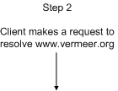
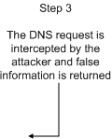



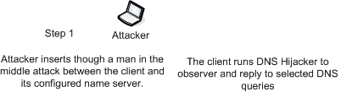
Man in the Middle Attacks
(DNS Hijacking)
Notes:
The attacker places himself between the client and the name server
The client makes a DNS request for resolution of www.example.org
This request is intercepted by the attacker who replies with false information
The DNS server replies with the correct information
Once again this is a race condition, the winner will be the first packet to the client

Slide 34
Man in the Middle Attacks
(DNS Hijacking)
The script used is called DNSHijacker and was released as proof of concept to store falsified resource record information
@plat# cat ftable
10.10.10.30 ns02.example.org
dnshijacker –f table udp src or dst port 53
[dns hijacker v1.3_4 ]
Sniffing on: eth0
Using filter: udp dst port 53 and udp src or dst port 53
Fabrication table: ftable
dns activity: 30.1.6.22:1027 > 30.1.1.100:53[ns02.example.org = ?]
dns activity: 30.1.6.22:1027 > 30.1.1.100:53[ns02.example.org = 10.10.10.30]
Notes:
Notice the first request asking for resolution of ns02.example.org and the spoofed answer returned by the attacker of 10.10.10.30

Slide 35
Man in the Middle Attacks
(DNS Hijacking)
#> nslookup
Default Server: ns01.example.net
Address: 10.10.10.53
> ns02.example.org
Server: ns01.example.net
Address: 10.10.10.53
Name: ns02.example.org
Address: 10.10.10.30
> exit
Notes:
This is a view from the client who was requesting this information for ns02.example.org

Slide 36
DNS Design Best Practice
  External hidden primary
  External secondaries
  Forwarder
  Hidden internal parent primary
  Internal parent secondary
  Hidden internal child primary
  Internal child secondaries
  Internal stealth secondaries
  Internal caching-only name servers
Notes:
My design best practices are built around large or distributed enterprise, depending on your environment it might make sense to combine some of the services.

Slide 37
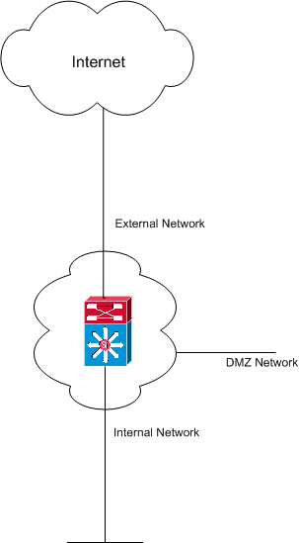
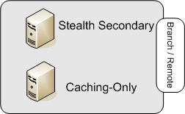
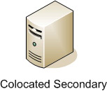
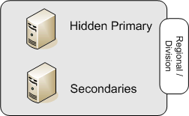



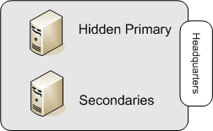
DNS Design Best Practice

Slide 38
DNS Design Best Practice
External hidden primary
- manage External zone data
- located inside the firewall
- unpublished and filtered to prevent querying by external name servers
- maximum service availability
Notes:
The External hidden primary at headquarters or the main datacenter, Allows for administrative flexibility, no need to wait to update a Server in use. Can be protected by the Firewall and also by ACL’s in DNS server itself. Restricted to only allow updates from specified servers and also allow Zone Transfers to certain servers.

Slide 39
DNS Design Best Practice
External secondaries
- advertise external zone data
- zone transfer from external hidden primary
- locations are network and geographically diverse (ISP or colocation facility)
- recursion and outbound zone transfer disabled to prevent cache poisoning
- protect against denial of service attacks
Notes:
The External Secondaries located in the DMZ or at the ISP, are Published for querying from external locations. Easy rebuild if needed from hardware failure or security breech. Restricted to only allow updates from Hidden Primary. Located closer to the ISP to allow for faster response times. Turning off recursion only lets the DNS server handle queries for what it knows about and not to be used for other purposes that would slow it down. Should still be sitting behind a firewall to block DoS attacks.

Slide 40
DNS Design Best Practice
Forwarder
- resolves Internet domain names on behalf of the internal name servers
- located inside the firewall
Notes:
The forwarder is located Internal and Allows for tighter access controls on firewalls as to which internal machines can query DNS externally. Works as a caching device as well to speed up queries. Should be redundant to allow for fail over.

Slide 41
DNS Design Best Practice
Hidden internal parent primary
- manage internal parent zone data
- located inside the firewall
- unpublished and filtered to allow maximum service availability, and administrative flexibility
- support zone dynamic updates
Example: example.net
Notes:
The Hidden Internal Parent Primary is located at the main datacenter or headquarters, This mainly allows for ease of management and performance. If many secondaries, allow for them to handle queries and allow for primary to handle Dynamic updates.

Slide 42
DNS Design Best Practice
Internal parent secondary
- name service to local resolvers
- query sort order for availability
Notes:
Again the Internal Parent Secondary is located at the main datacenter or headquarters and is configure to query closer secondary first, then other secondary to minimize delay and provide fallback. Also queries the forwarder to allow for maximum performance and turn off caching.

Slide 43
DNS Design Best Practice
Hidden internal child primary
- manage internal child zone data
- located inside the firewall
- hidden to allow maximum service availability, and administrative flexibility
- support zone dynamic updates
Example: cincinnati.example.net
Notes:
The Hidden Internal Child Primary is Similar to a Hidden internal parent primary but allows for department or country management flexibility and is located Regional or by Division

Slide 44
DNS Design Best Practice
Internal child secondaries
- name service to local resolvers
- query sort order for availability
Notes:
The Internal Child Secondaries is located Regional or by Division and is Configure to query closer secondary first, then other secondary to minimize delay and provide fallback. Same as Parent Secondary but also allows for easier management for disparate departments or countries.

Slide 45
DNS Design Best Practice
Internal stealth secondaries
- secondary zones for most often queried by remote resolvers
- stealth to prevent internal name servers from querying secondary across wan link
- query sort order for availability
Notes:
The Internal Stealth Secondaries is located at the Branch or Remote site and stealth to prevent internal name servers from querying secondaries across the slow WAN link.

Slide 46
DNS Design Best Practice
Internal caching-only name servers
- name service to local resolvers
- build a local cache of queried data
- query sort order for availability
Notes:
The Internal caching-only is located at the Branch or Remote site to provide local caching-only name service for the remote office.

Slide 47
DNS Design Best Practice

Slide 48
Q & A

Slide 49
Contact Information
mearls@vermeer.org
http://www.vermeer.org
http://www.vermeer.org/pgp

